Slide 1
Chapter 10
Introduction to Simple Experiments

Slide 2
Reminders
Chapter 10 Assignments due November 11th at 11:59 pm
  Ebook: Chapter 10
  InQuizitive: Chapter 10

Slide 3
Agenda
A Quick Refresher
Experiments and Causal Claims
Experiment Group Designs
(Some) Concerns in Experimental Designs
Interrogating Experiments with the Big Four Validities
Next time on PSY 270…

Slide 4

A Quick Refresher…

Slide 5
Variable Refreshers
Variable – something that changes or varies, so it can have 2+ levels
  Levels/ conditions – Different options within a variable
Control variable – something within the experiment that stays the same
Manipulated variable – the variable the experimenter controls
  Also called the independent variable or predictor variable
Measured variable – the variable observed and recorded
  Sometimes called the dependent variable or outcome variable

Slide 6
Experiment Groups Refresher
Control group – the condition that receives no treatment
Placebo group – the group that receives a placebo instead of a treatment
Treatment group(s) - the group(s) that receive the treatment(s)

Slide 7

Class Activity: Name that Variable!
Grab a worksheet
I will read through a handful of experiment scenarios, and you will decide if each variable is a control, manipulated, or measured variable

Slide 8
Scenario 1: Music Puzzles
Researchers randomly assign students to complete a puzzle while listening to either classical music or pop music. They record how long each student takes to finish.
  Type of Music
  Completion Time
  What are the levels of our manipulated variable(s)?
Notes:
Manipulated
Measured

Slide 9
Scenario 2: Sleep and Memory
Researchers randomly assign participants to sleep either 6 or 8 hours of sleep before completing a memory test. For the experiment, the participants stay overnight in the sleep lab.
  Hours of sleep
  Memory score
  Sleep environment
  What are the levels of our manipulated variable(s)?
Notes:
manipulated
Measured
control

Slide 10
Scenario 3: Caffeine and Alertness
Researchers randomly assign participants to receive a drink containing either 0 mg, 100 mg, or 200 mg of caffeine. All drinks contain 12 ounces of liquid, and every participant completes the experiment at 9:00 a.m. Participants report how many hours they slept the previous night. After drinking, researchers measure reaction time on a computer task and ask participants to rate their alertness.
  Amount of caffeine
  Amount of liquid
  Time of testing
  Reaction time
  Self-reported alertness
  Hours of sleep the previous night
  What are the levels of our manipulated variable(s)?
Notes:
Manipulated
Control
control
Measured
Measured
Measured

Slide 11
Question for the Class
What makes an experiment different from a correlational study? (Use the terms manipulated and measured in your answer.)
Notes:
Corr = 2 measured
Exp = at least 1 of each

Slide 12
Match the Following Terms
Common Correlational Phrasing:
Predictor Variable
Outcome Variable
Common Experimental Phrasing:
Dependent Variable (DV)
Independent Variable (IV)

Slide 13
Experiments and Causal Claims
Experiments establish covariance
Experiments establish temporal precedence
Well-designed experiments establish internal validity

Slide 14
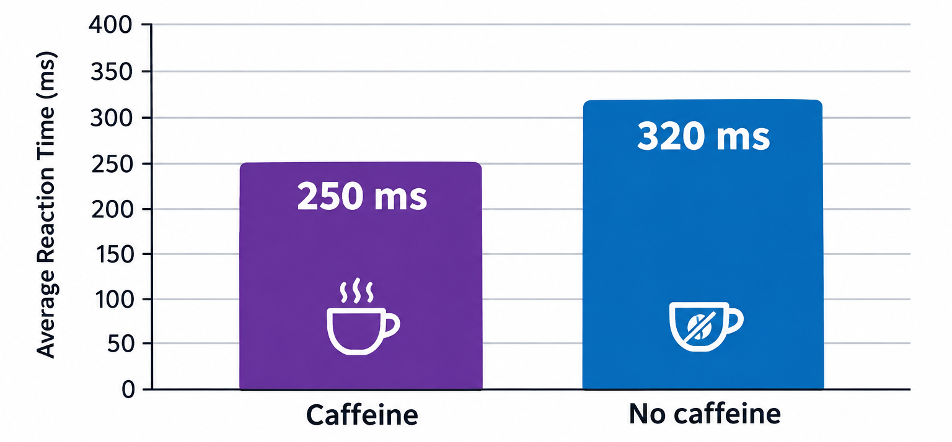
Experiments Establish Covariance
If changing from IV level 1 to IV level 2 is associated with a change in the DV, you have established covariance
  In other words, a change in one variable is associated with a change in another variable

Slide 15
Experiments Establish Temporal Precedence
By controlling the experiment, you control the order of the variables
Ex:
  Step 1: have someone drink caffeine
  Step 2: measure their reaction times

Slide 16
Well-Designed Experiments Establish Internal Validity
By random assigning people to groups, you are “canceling out” many potential third variables
HOWEVER, if you are not careful in how you design the study, you may accidentally add other third variables into the experiment

Slide 17
Threats to Internal Validity
Design confounds – an additional variable that varies systematically alongside the independent variable
  Systematic variability – when an additional variable is coinciding with study variables in a pattern (a threat to internal validity)
    Ex: when you are measuring the effect of calendar month (IV) on ice cream sales (DV), and temperature changes match the trends in increased sales during summer months
  Unsystematic variability – when an additional variable is coinciding with study variables, but the effects are haphazard and random
    Ex: when you are measuring the effect of calendar month (IV) on ice cream sales (DV), and whether the participants have already eaten dinner will decrease their chances of eating ice cream, but it’s random across the different months how many people had already eaten dinner, so isn’t potentially driving the impact of the IV (not a threat to internal validity)

Slide 18
Threats to Internal Validity
Selection effect – when the participants in one level of the IV are systematically different than the participants in the other level or levels of the IV
  Ex: If you’re trying to determine if tutoring improves student grades, and you compare a sample of 10 people who go to the Loper Success Hub for tutoring against 10 other students in the class who don’t go to tutoring
Solution 1: random assignment
  If you randomly assign some students to a tutoring treatment, while assigning other students to a control, you are balancing the odds that you will have students who already would have been seeking tutoring help into each condition
Solution 2: matched groups
  If you have 10 students who already go to the Loper Success Hub, split 5 into the tutoring group and 5 into the control group
Notes:
If you randomly assign some students to a tutoring treatment, while assigning other students to a control, you are balancing the odds that you will have students who already would have been seeking tutoring help into each condition

Slide 19
Experiment Group Designs
Between-Subjects Designs
Within-Subjects Designs
Mixed Designs

Slide 20
Designs for Testing Group Differences
Between-subjects designs (also called between-groups or independent-groups) – when subjects are split between levels/ conditions
  Ex: Posttest-only designs
Within-subjects designs (also called within-groups design; variants include paired samples designs) – when the same subjects are assessed more than once
  Ex: Pretest/ posttest, repeated-measures, and concurrent-measures designs
Notes:
-Most other between designs beyond post-test are mixed designs
-Other within subjects designs can include 2 treatments, or even matched pairs (each half of a couple reporting their communication ratings of each other to determine if there is an increase in comm rating for the more feminine partner)

Slide 21
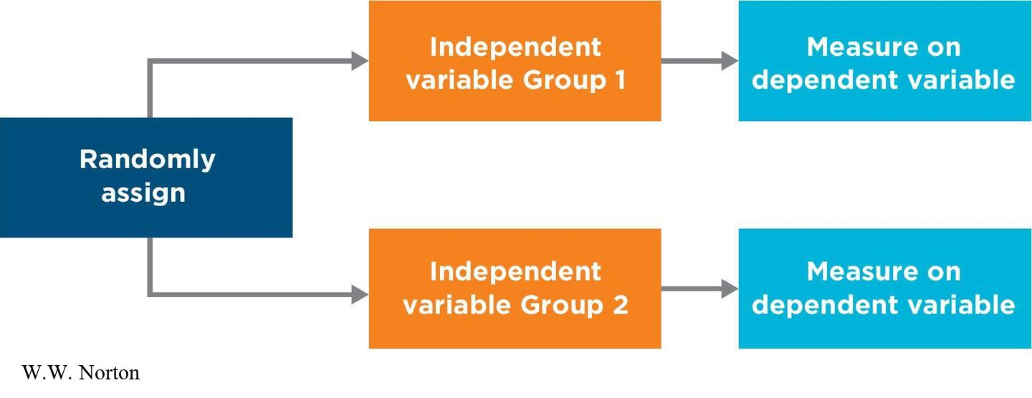
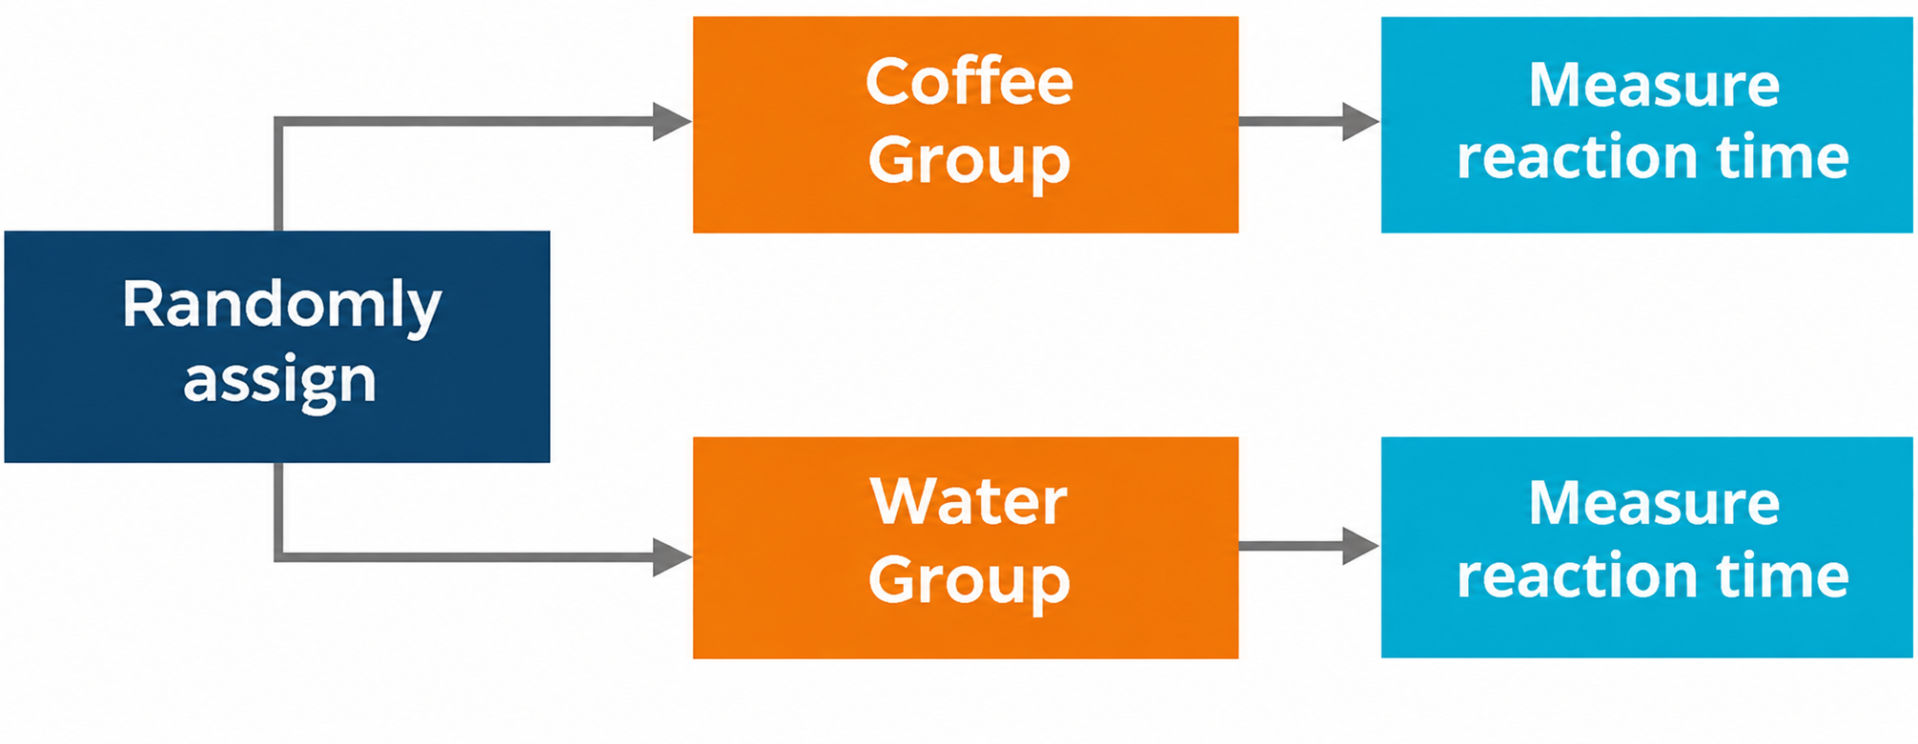
Posttest-Only Designs
Posttest-only design – subjects only tested after the intervention or treatment
  A type of between-subjects design

Slide 22
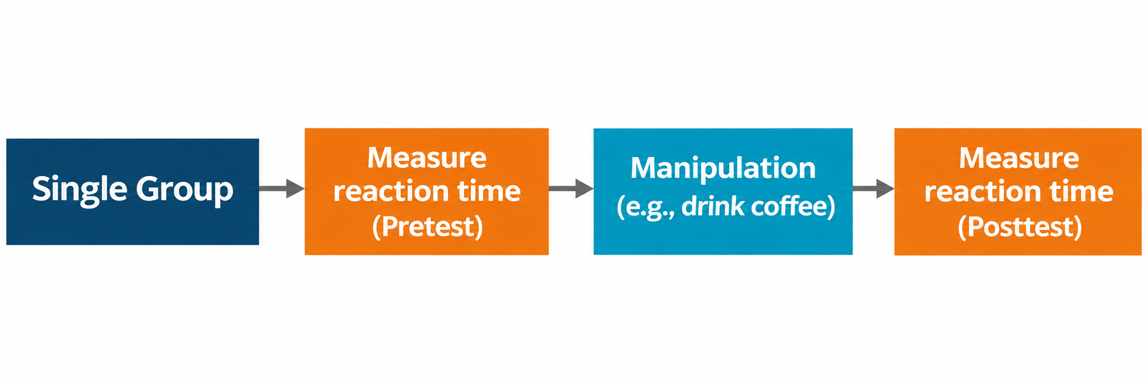
Pretest/Post Design
Pretest/posttest design – when each participant is measured before and after a treatment
  A type of within-subjects design

Slide 23
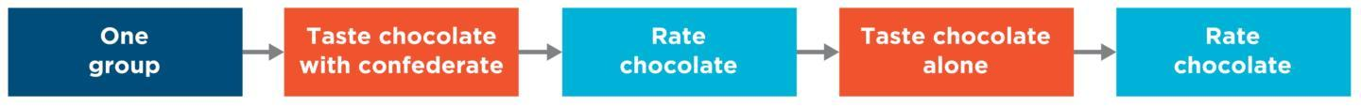
Repeated-Measures Design
Repeated-measures design – when participants are measured more than once, after exposure to each level of the independent variable
  A type of within-subjects design
  Will be repeated for however many levels of the IV are in the study

Slide 24
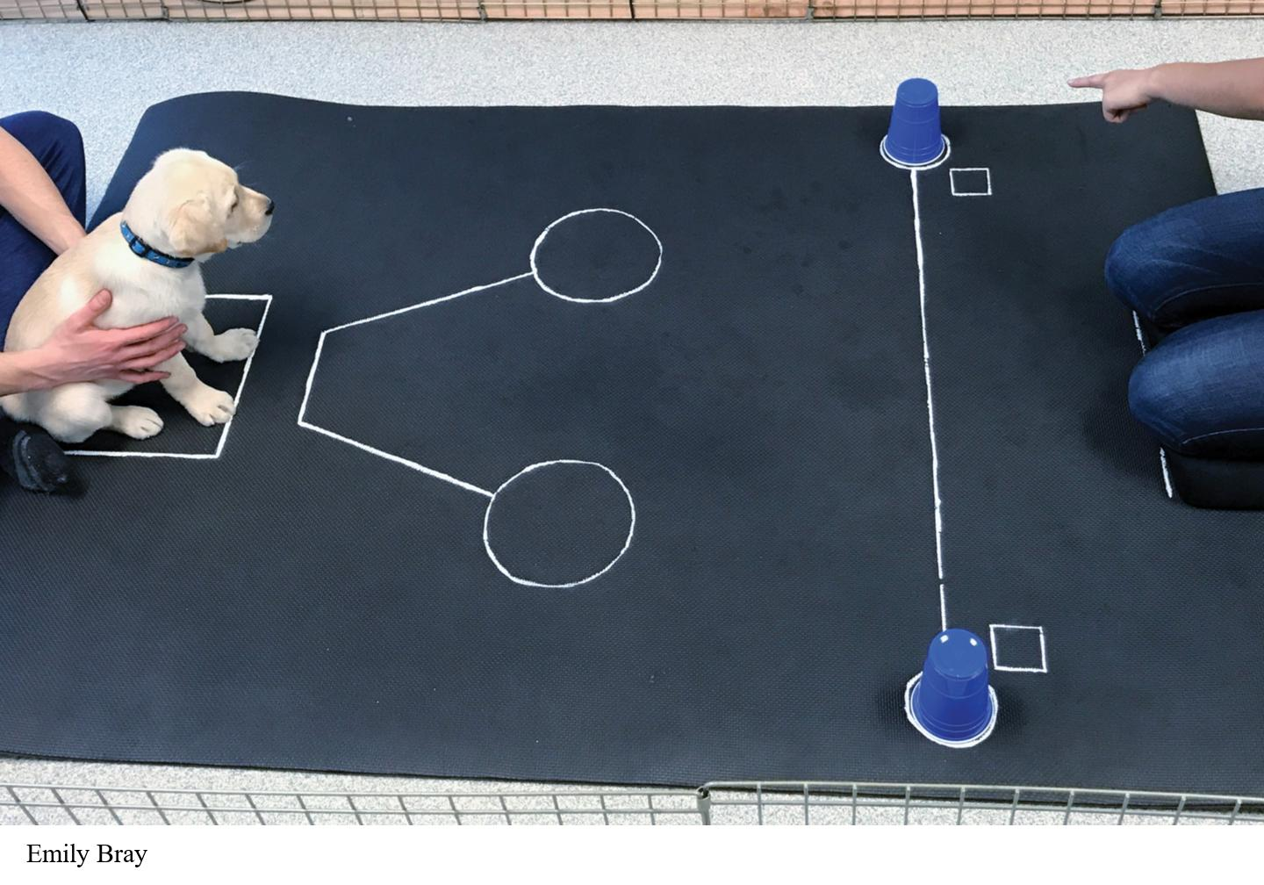
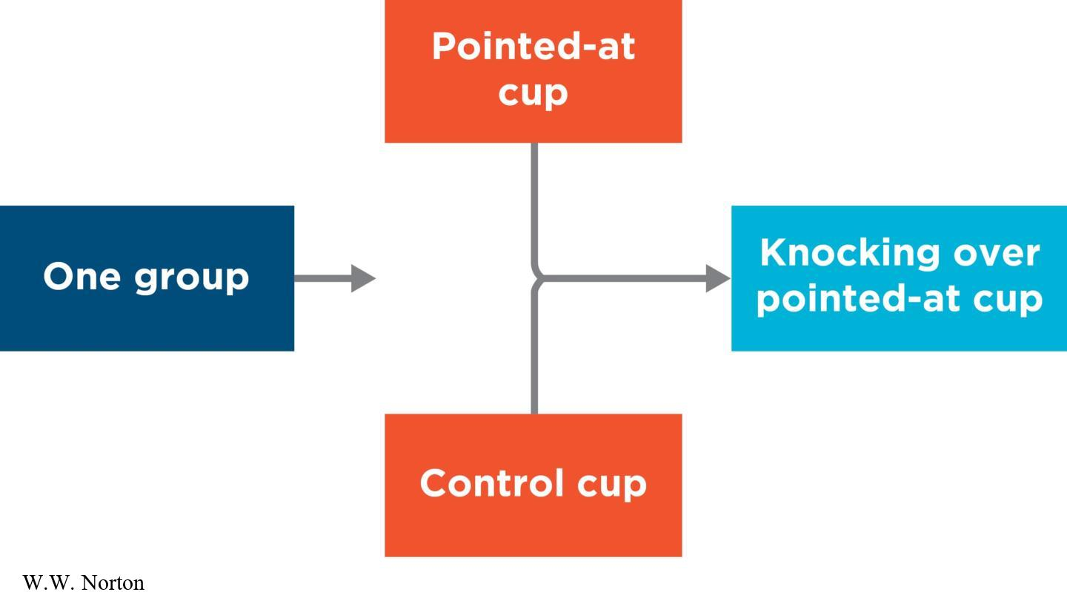
Concurrent-Measures Design
Concurrent-measures design – subjects exposed at different levels of the IV at the same time
  A type of within-subjects design
  Preference is typically the DV

Slide 25
Within vs. Between Designs
Within
Between
-Can have smaller sample size (which can make it cheaper)
-Reduces random error due to individual differences in participants
-Can increase time needed per participant
-Greater attrition (drop out) concerns
-Runs the risk of carryover and subject expectancy effects
-The “control” for each participant is themselves, making causal claims more complicated
-Requires more participants
-Increases the chance of error due to individual differences
-Can reduce the time burden per participant
-Reduces attrition (drop out) concerns
-Reduces the risk of carryover and subject expectancy effects
-Can randomly sort people into groups, making causal claims stronger

Slide 26
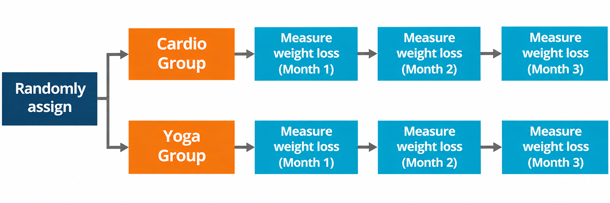
Mixed Designs
Mixed designs – when the experiment blends between and within subjects; groups are assigned to different levels of an IV, but each group is measured more than once

Slide 27
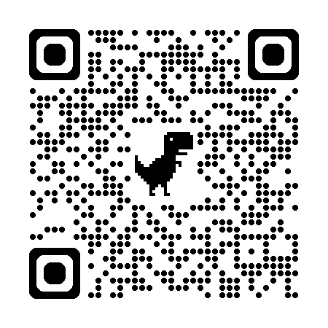
Class Activity: Deep or Shallow
Grab a worksheet
Use the following website to flip a coin (unless you happen to have a coin) https://flipsimu.com/
At the top of the page, write if you were heads or tails

Slide 28
If you are in the tails group, close your eyes and put your head down!

Slide 29
Heads Group Instructions:
SHHH… no questions/ reading this aloud!
In a moment, I will read a list of words
For each word, decide if it is pleasant (how you define pleasant is up to you)
ONLY write yes or no on your paper for each

Slide 30
If you are in the heads group, close your eyes and put your head down!

Slide 31
Tails Group Instructions:
SHHH… no questions/ reading this aloud!
In a moment, I will read a list of words
For each word, decide if contains an “e” OR a “g”
ONLY write yes or no on your paper for each (yes if it is has both/ either, no if it has neither)

Slide 32
Ready to begin?
Notes:
1. Evening
2. Country
3. Salt
4. Easy
5. Peace
6. Morning
7. Pretty
8. Expensive
9. Poor
10. Doctor
11. City
12. Dry
13. Cold
14. Love
15. Bargain
16. War
17. Hate
18. Wet
19. Rich
20. Nurse
21. Pepper
22. Hard
23. Ugly
24. Hot

Slide 33
Class Discussion
What were your instructions?
What was the independent variable?
What were the levels of the independent variable?
What was the dependent variable?
Was this a between subjects or within subjects design?
Which type of design was this (pretest/posttest, posttest only, concurrent, repeated measures, etc.)?
Notes:
Pleasant = deep processing; e/g = shallow processing
Hypothesis = remember more from deeper processing
Chew, S. L. (2010, April). Improving classroom performance by challenging student misconceptions about learning. APS Observer (online edition). Downloaded from http://bit.ly/2uVq9EK. (I think this is for this study)

Slide 34
(Some) Concerns in Experimental Designs
Order Effects
Demand Characteristics

Slide 35
Order Effects
Order effects – where performance at the first time point impacts performance at the second time point
  A concern for within-subjects designs
  Practice effects – when people perform better the second time because they have already practiced the task
  Fatigue effects – when people perform worse the second time because they have grown tired and begin to make mistakes
  Carryover effect – when there is contamination carrying over from one condition to the next
Notes:
-Practice: completing a maze is easier after you’ve solved one similar
-Fatigue: when your memory is strained from already having to remember a lot
-Carryover: when you brush your teeth and then drink orange juice, the (unpleasant) taste of the orange juice is a carryover effect of brushing your teeth.

Slide 36
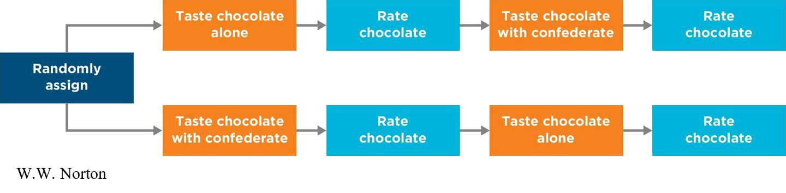
Order Effects and Counterbalancing
The solution to order effects is counterbalancing
Counterbalancing – randomly assigning some participants to complete each of the two variations first

Slide 37
Demand Characteristics
Demand characteristics – when participants develop their own hypotheses about the purpose of the study and how the experimenter wants them to behave
  Sometimes the guesses are correct and sometimes they’re not, but either way, it’s impacted the accuracy of the data
  More of a concern for within-subjects design than between-subjects design
  Solution: Be sneakier?
Notes:
Note: reactivity is when people change how they’re acting when they know they’re being watched; demand characteristics is about them guessing the hypotheses and changing to counter or match hypothesis

Slide 38
Interrogating Experiments with the Big Four Validities
Construct Validity
External Validity
Statistical Validity
Internal Validity

Slide 39
Construct Validity
Construct Validity – How well were the variables measured?
Dependent variables: How well were they measured?
Independent variables: How well were they manipulated?
  Manipulation checks
  Pilot studies
Notes:
A manipulation check is an extra dependent variable that researchers can insert into an experiment to convince them that their experimental manipulation worked. Ex: rating a humor on a comic strip, to make sure people found it funny before going on to assess types of humor
Pilot study – typically completed before the primary study (though the book says after, which I mostly disagree with); typically used as a test run to make sure the variables are behaving like you’d expect

Slide 40
External Validity
External Validity – To whom or what can the causal claim generalize?
Generalizing to other people
Generalizing to other situations
What if external validity is poor? Does that always matter?

Slide 41
Statistical Validity
Statistical Validity – How much? How precise? How consistent are the values?
Effect size
Confidence intervals and statistical significance
Replication (with a similar sample and design)
Notes:
Deliberately changing participant variables in a replication would evaluate external validity, while trying to keep things the same would evaluate statistical validity

Slide 42
Internal Validity
Internal Validity – Are there alternative explanations for the results?
Were there any design confounds?
If an independent-groups design was used, did researchers control for selection effects using random assignment or matching?
If a within-groups design was used, did researchers control for order effects by counterbalancing?

Slide 43
Research Activity #10
We will watch a video about a study in a moment (this provides background for the study you will complete your worksheet about)
Next, you will get in groups and grab a worksheet
Then, you will go to a popular news article about a newer version of the study
Finally, you will complete the worksheet (based on the news source) and turn it in by the end of the day

Slide 44
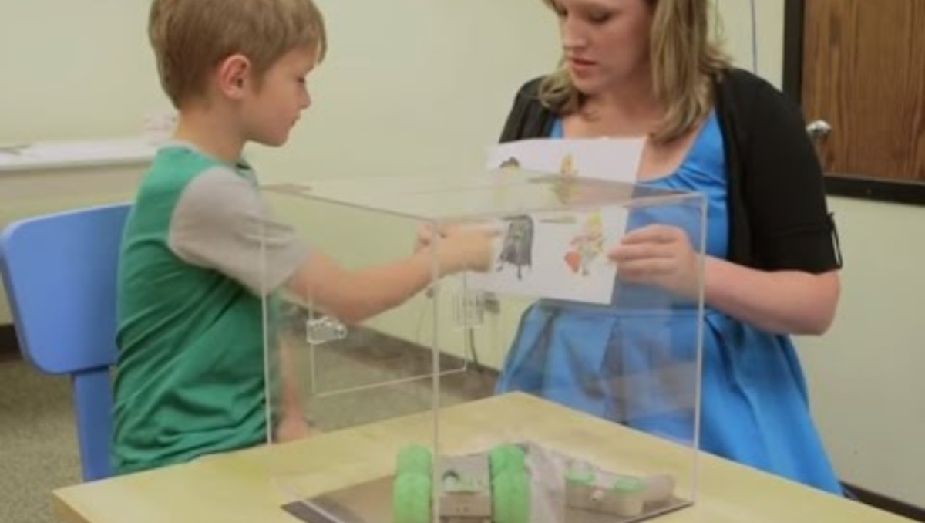
https://youtu.be/CKAxGlWrByE?si=q9HbyjhseRcBiy8m
Notes:
https://youtu.be/CKAxGlWrByE?si=q9HbyjhseRcBiy8m

Slide 45
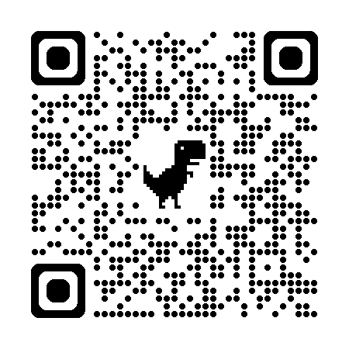
Research Activity #10
Go to the following news source
(https://www.bps.org.uk/research-digest/pretending-be-batman-helps-kids-stay-task )
Complete the worksheet and turn it in by the end of the day

Slide 46
Next Time on PSY 270…
Before Next Class(es):
Read Chapter 10 and complete Ebook: Chapter 10 assignment
  Due 11/11 at 11:59 pm
Complete InQuizitive: Chapter 10
  Due 11/11 at 11:59 pm
Next Class:
Chapter 11

